Slide 1

Country School Association of America 2016 Conference Fredericksburg, Texas ON THE LAND, LEARNING AT HAND
Country School Association of American National Conference: June 19-22, 2016 Fredericksburg, TX

Slide 2
Country School Association of America National Conference
June 19, 20, 21, 22, 2016
Pioneer Museum Fredericksburg, Texas

Slide 3

Hosted by: Friends of the Gillespie County Country Schools
Fredericksburg, Texas
www.historicshools.org
Country School Association of American National Conference: June 19-22, 2016 Fredericksburg, TX

Slide 4
Conference Lodging
Country School Association of American National Conference: June 19-22, 2016 Fredericksburg, TX

Slide 5
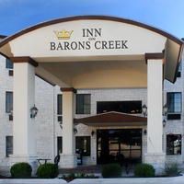
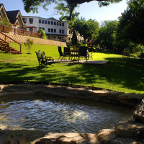
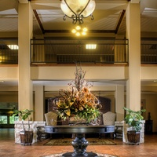
Conference Lodging: Inn on Barons Creek
Country School Association of American National Conference: June 19-22, 2016 Fredericksburg, TX

Slide 6
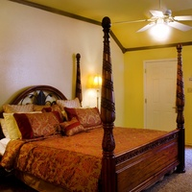
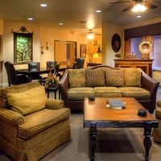
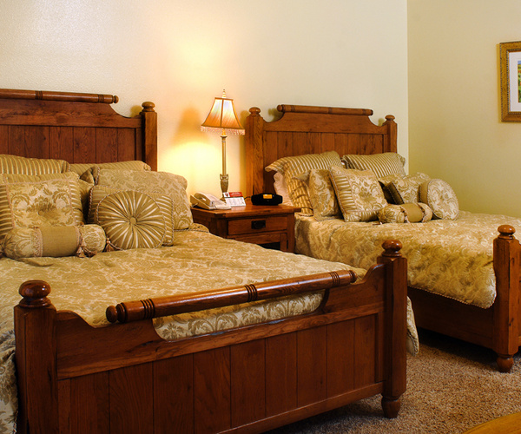
Conference Lodging: Inn on Barons Creek Accommodations
Country School Association of American National Conference: June 19-22, 2016 Fredericksburg, TX

Slide 7
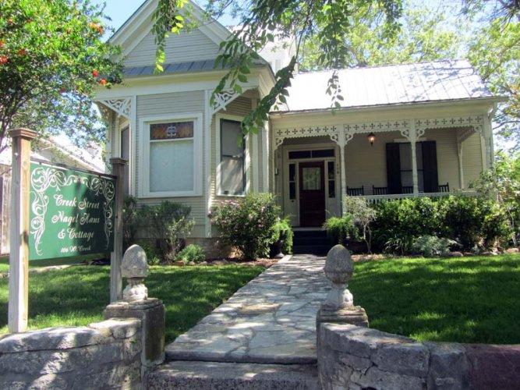

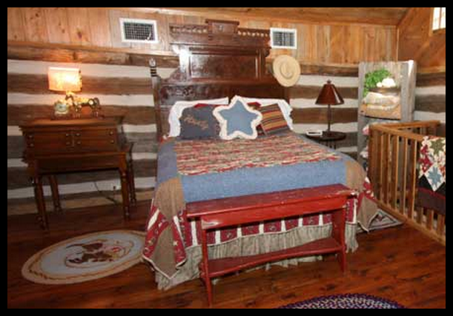
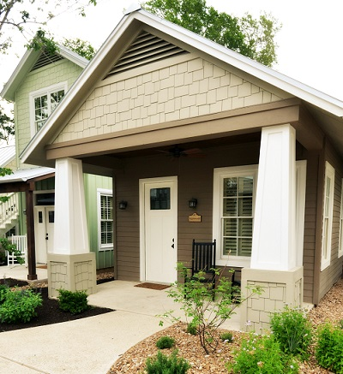
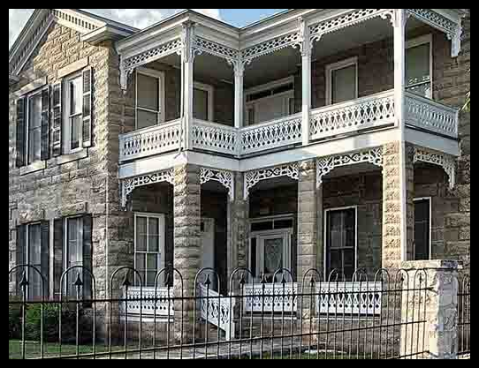
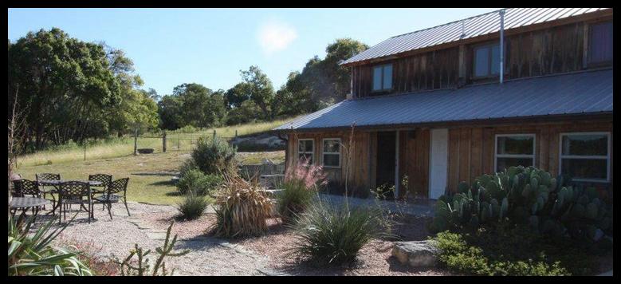
Or Stay in Bed & Breakfasts – Guesthouses - Inns
Country School Association of American National Conference: June 19-22, 2016 Fredericksburg, TX

Slide 8
Conference Meeting and Tours
Country School Association of American National Conference: June 19-22, 2016 Fredericksburg, TX

Slide 9
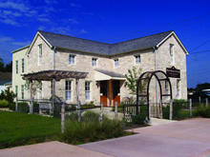
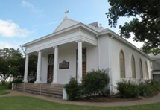
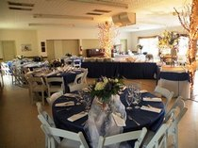
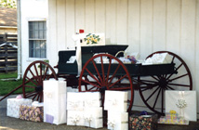
Conference Meeting & Tour: Pioneer Museum
Country School Association of American National Conference: June 19-22, 2016 Fredericksburg, TX

Slide 10
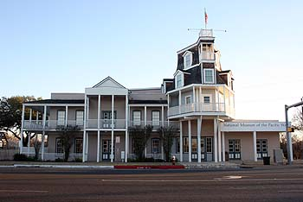
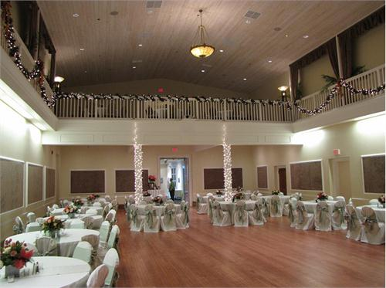
Nimitz Museum Self Guided Tour of Museum & Dinner Monday, June 20
Country School Association of American National Conference: June 19-22, 2016 Fredericksburg, TX

Slide 11

Schoolgirl Sampler Exhibit at the Pioneer Museum May 2 – June 30
Country School Association of American National Conference: June 19-22, 2016 Fredericksburg, TX

Slide 12
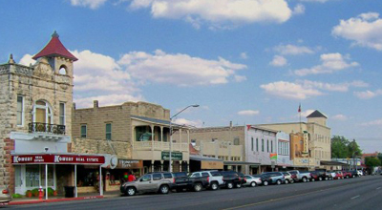
Tour of Fredericksburg
Country School Association of American National Conference: June 19-22, 2016 Fredericksburg, TX

Slide 13
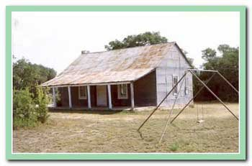
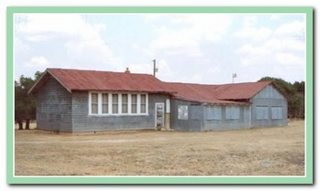
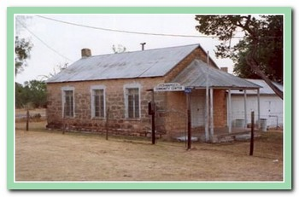
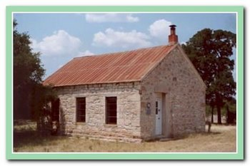
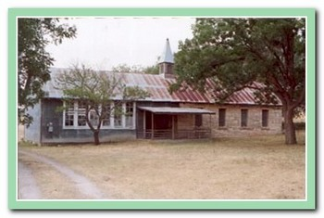
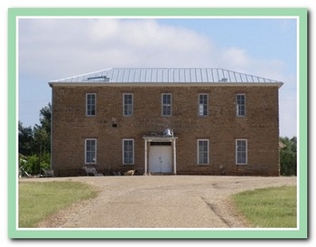
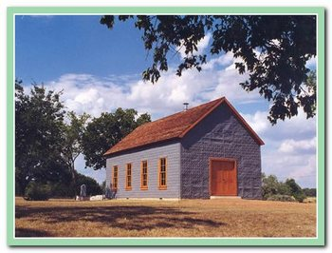
Country School Bus Tour – Wednesday, June 22
7 Schools - Reservation Required: Limit of 55
Country School Association of American National Conference: June 19-22, 2016 Fredericksburg, TX

Slide 14
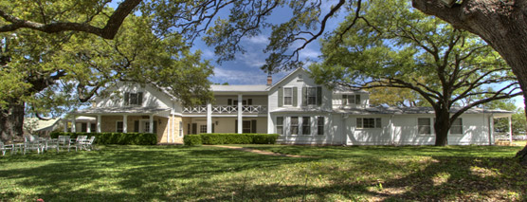
Texas White House LBJ Ranch
Included in Bus Tour – Wednesday, June 22
Reservation Required: Limit of 55
Country School Association of American National Conference: June 19-22, 2016 Fredericksburg, TX

Slide 15
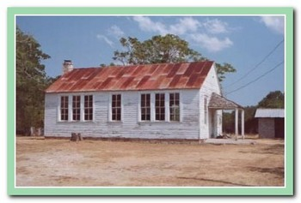
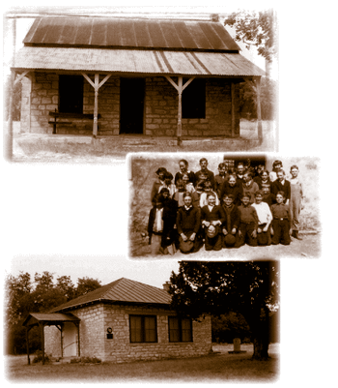
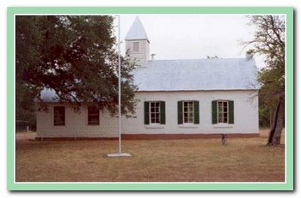
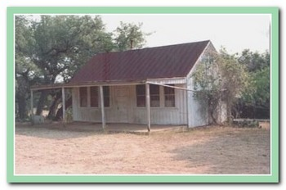
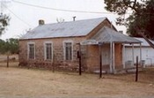
Self-drive School Tour, 10 Schools Open
June 19th: 12:30-4:40 PM
Country School Association of American National Conference: June 19-22, 2016 Fredericksburg, TX

Slide 16
See CSAA website: www.CountrySchoolAssociation.org for registration & conference information or Friends of the Gillespie County Country Schools at: www.historicschools.org for Conference information and updates.
Registration Begins January 15, 2016

Slide 17
Special Thanks to our Partners
Country School Association of American National Conference
June 19-22, 2016 Fredericksburg, TX
Pioneer Museum LBJ National and State Historic Park
Nimitz museum of the Pacific War Dalton Fromme, Graphic Artist
Nimitz Foundation Fischer & Wieser Jelly and Jam
City of Fredericksburg Inn on Barons Creek
Texas Hill Country Wineries Website Solutions
Texas Historical Commission –Texas Hill Country Trails Region
Needle Work Press-Vickie Jennet Gillespie County

